Slide 1
VIETNAM
Introduction

Slide 2

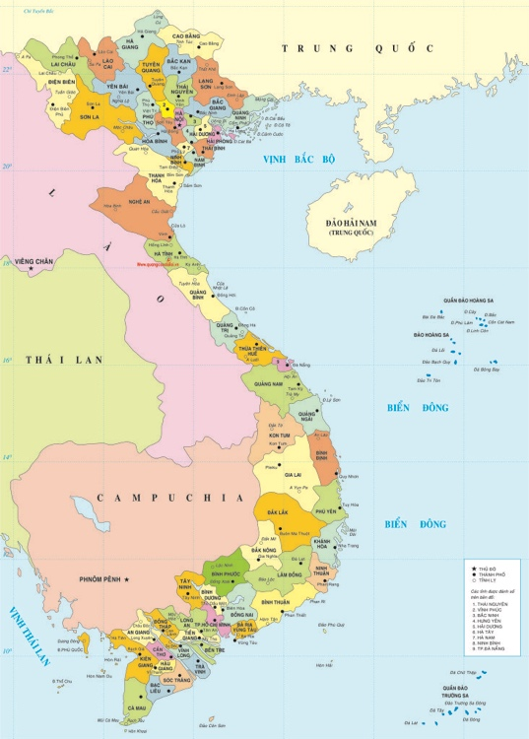

VietNam

Slide 3



VietNam
Capital | Hanoi
Total area | 331.000 km2
Population | 90 million
Province | 58 provinces and 5 cities (municipalities)
More interesting ....

Slide 4
OVERVIEW OF E-GOVERNMENT

Slide 5
“E-Government is the government which applies IT(ICT) to improve the effectiveness and efficiency of state agencies’ operations, promote the publicity and transparency of information, and provide better public service for people and enterprises”

Slide 6
Services of E-Government
G2C – Government to Citizens
G2B – Governemnt to Business
G2G – Government to Government
G2E – Government to Employees

Slide 7
Development stages of E-government
Complication level
Integrate and interconnect between different agencies
Transformation
Gaps on management level
Perform online transaction and settlement through network
Transaction
Gaps on technology
2-way interactive communication via electronic portal
Interaction
1-way communication, providing online information through websites
Gaps on technology
Presence
Benefit level

Slide 8
ONLINE PUBLIC SERVICES
Leve-1: are services which guarantee sufficient information on administrative procedures and relevant documents relating to those administrative procedures
Level-2: are level-1 online public services which enable users to download document templates and declare to complete dossiers as requested. Completed dossiers will be directly submitted or couriered to service providing agencies/organizations

Slide 9
ONLINE PUBLIC SERVICES
Level-3: are level-2 online public services which enable users to fill and send online document templates to service providing agencies/organizations. Transactions during document handling process and service provision process are done on internet. Fee payment (if any) and result receipt are directly done at service providing agencies/organizations.
Level-4: are level-3 online public services which enable users to make payment for fee (if any) on internet. The result return can be done online, directly sent our couriered to users.

Slide 10
RESOLUTION OF VIETNAMESE GOVERNMENT ON EGOV
Taipei, 3/2016

Slide 11

CONTENTS
1
Introduction
2
Resolution’s main contents
3
Role of Office of the Government
4
Achieved results

Slide 12
1. Introduction
Vietnamese Government has focused on IT application in public administration
In 2014, National Committee on IT application was founded and chaired by the Prime Minister
The Committee works on IT and eGov development policy

Slide 13
1. Introduction
A national online service portal has not been established
National databases are being developed as the foundation for all information systems and eGov
National telecom infrastructure has been deployed to commune level with specialized network

Slide 14
1. Introduction
Agencies have developed document management systems, website/portals, basic online services
Office of the Government always pioneers IT and eGov initiatives
The first Government’s Resolution on eGov was promulgated on 14 October 2015

Slide 15
1. Introduction
eGov Development Orientation
Administration reform,
better serve people
eGov framework,
eGovernance for authorities
GOALS
IT application and development

Slide 16
1. Introduction
Connecting document management systems
Online services on National portal
eGov
foundation
REQUIREMENTS
National databases and information systems
Data and information shared, national ID provided

Slide 17
2. Resolution’s main contents
Raise 3 indices: online service, telecom
infrastructure and human capital
Intercommunicate edoc from
Government to commune level
Main
Tasks
Establish National Online Service
Portal at one exclusive address
Associate administration reform with
IT and implement eISO
Enhance telecom network speed and
quality

Slide 18
2. Resolution’s main contents
Solution 1 – Finance
3 sources of budget:
IT as an economic industry in the State budget system (as stipulated by Law on IT in 2006)
Budget for science and technology
Vietnam Public Utility Telecommunication Sevice Fund

Slide 19
2. Resolution’s main contents
Solution 2 – Investment
New policies on Investment:
Developing a pilot policy on investment, procuring and leasing IT products and services
Direct contracting: Ministers and Chairmen of peoples’ commitees at provincial levels can choose direct contracting

Slide 20
2. Resolution’s main contents
Solution 3 – Human resources
Developing and promulgating ocupational criteria for IT officials
Making new policies to attract and employ IT experts
Training IT leadership, information security leadership

Slide 21
2. Resolution’s main contents
Solution 4 – Deployment
Focus on prioritized fields:
Hot spots like construction, environment, transport, land
Fields with major impact: business registration, investment registration
Fields with high chances of corruption

Slide 22
2. Resolution’s main contents
Solution 5 – Technical
Connecting information systems to share and exploit common data
Improving transmission quality of specialized networks, Internet and 3G
Providing user-friendly and multilingual online services
Ensuring utmost safety and security for eGov

Slide 23
2. Resolution’s main contents
Solution 6 – Arrangement
Head of each agency is responsible for the institution’s IT application. One Deputy Head must be directly assigned to lead IT application and eGov
Specific tasks for ministries and localities with respective time frame

Slide 24
2. Resolution’s main contents
1. Intercommunicating eDoc
2. Integrating online services
3. Business registration
4. Land and construction management
5. Health insurance
6. Visa grant
7. Intelligent electricity measurement
Large
Systems
8. Intelligent traffic control

Slide 25
3. Role of Office of the Government
Intercommunicating
eDoc systems
before 01 June 2016
eSuggestion system for
legal document and
Society-Authority network
National Online Service
Portal
OG’s
Tasks
Declaring progress of
form processing on
Government portal
Business website
on State-owned
Enterprises
Pilot policy on investment,
procurement and leasing
IT product/service

Slide 26
3. Role of Office of the Government
Implementation
1
2
Leading the task of developing eGov and impementing the Resolution
Leading the inspection, monitoring and control of Resolution’s implementation to report to the Government
Resolution’s implementation result will be used to
appraise government’s agencies performance
at the Government’s year-end regular meeting

Slide 27
4. Achieved results
Technical
requirements
Technical requirements by Ministry of Information and Communication, compatible with eGov architecture framework
Existing document management systems need to add edXML header in the message

Slide 28
4. Achieved results
City level
District, commune,
Departments
General Model
Connection Axis
Document
management
Document
management
Communicating with provinces
and agencies via connection axes
Ho Chi Minh city
Search and research service
Ha Noi
Office of the Government
Information systems
Da Nang
Connection axis of ministries and other agencies

Slide 29
4. Achieved results
Result of the pilot phase
03
02
01
Phase 2: 26 ministries and 40 provinces
Via connection axis, documents are exchanged seamlessly, together with the status of processing
Phase 1: connecting Office of the Government with 23 provinces by 25 August 2015

Slide 30

4. Achieved results
Appraise the solution and achieved results
Establish the foundation for eGov
Evaluation
Complete the Master solution, ensure security
and safety
Foundation
Completion
Next
Steps
Report
Report to Prime Minister for nationwide roll-out
Connecting other information systems
Deployment

Slide 31



Questions and Answers

Slide 32
Thank you!

